Slide 1




Near-Space Atmospheric Measurements
Pima Community College Northwest
Ascend April 2017
Christopher Mastrangelo, Colton Stoltz, Bryce Klein
Mike Sampogna, Physics Dept., Pima Community College NW
Notes:
1 minute per slide means 7 slides

Slide 2
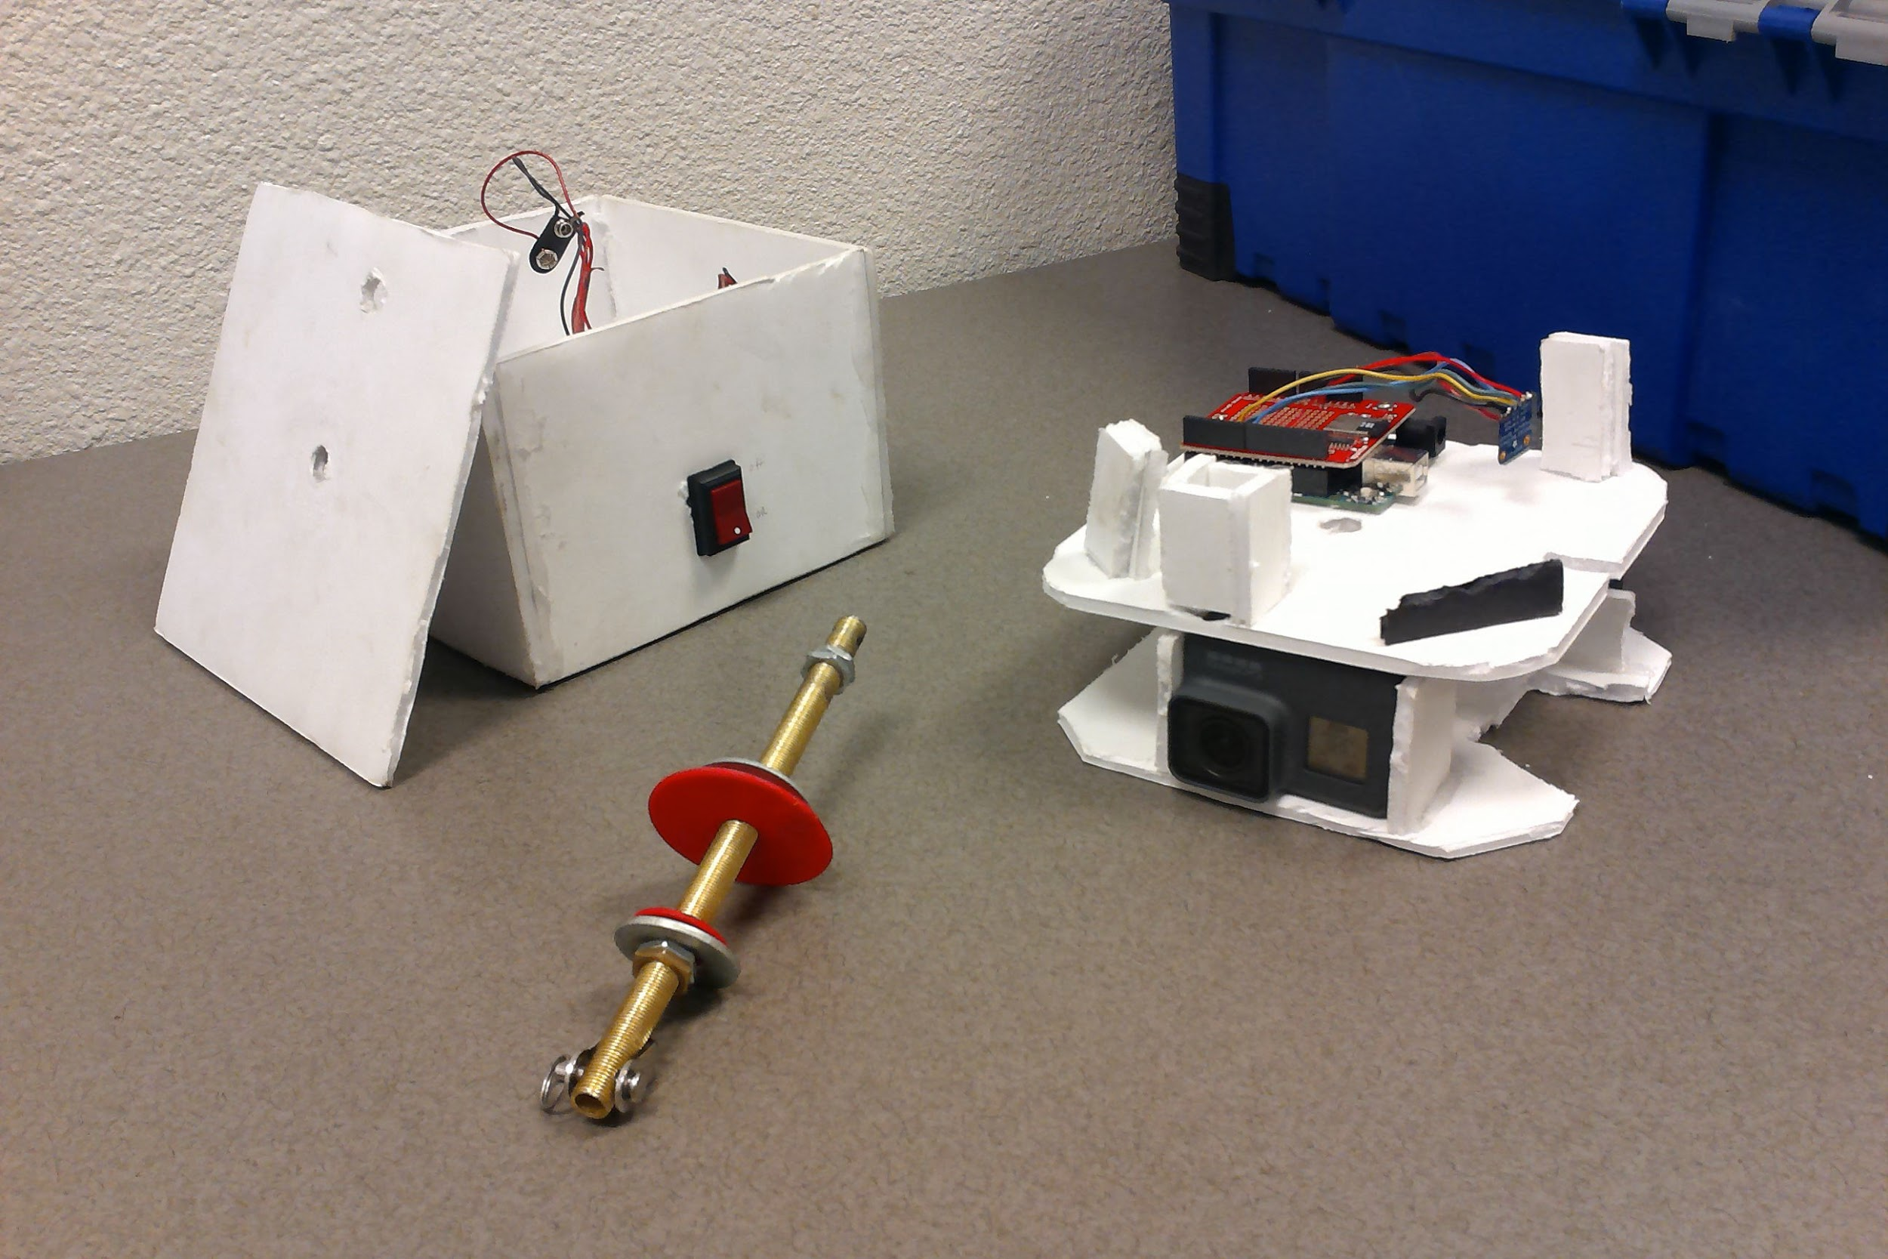
Device Components
Foam Box - 16.5cm x 11.5cm x 16 cm
Brass plated rod - 3mm x 180mm
GoPro Hero 5 Black Camera
Arduino Uno Microcontroller

Slide 3
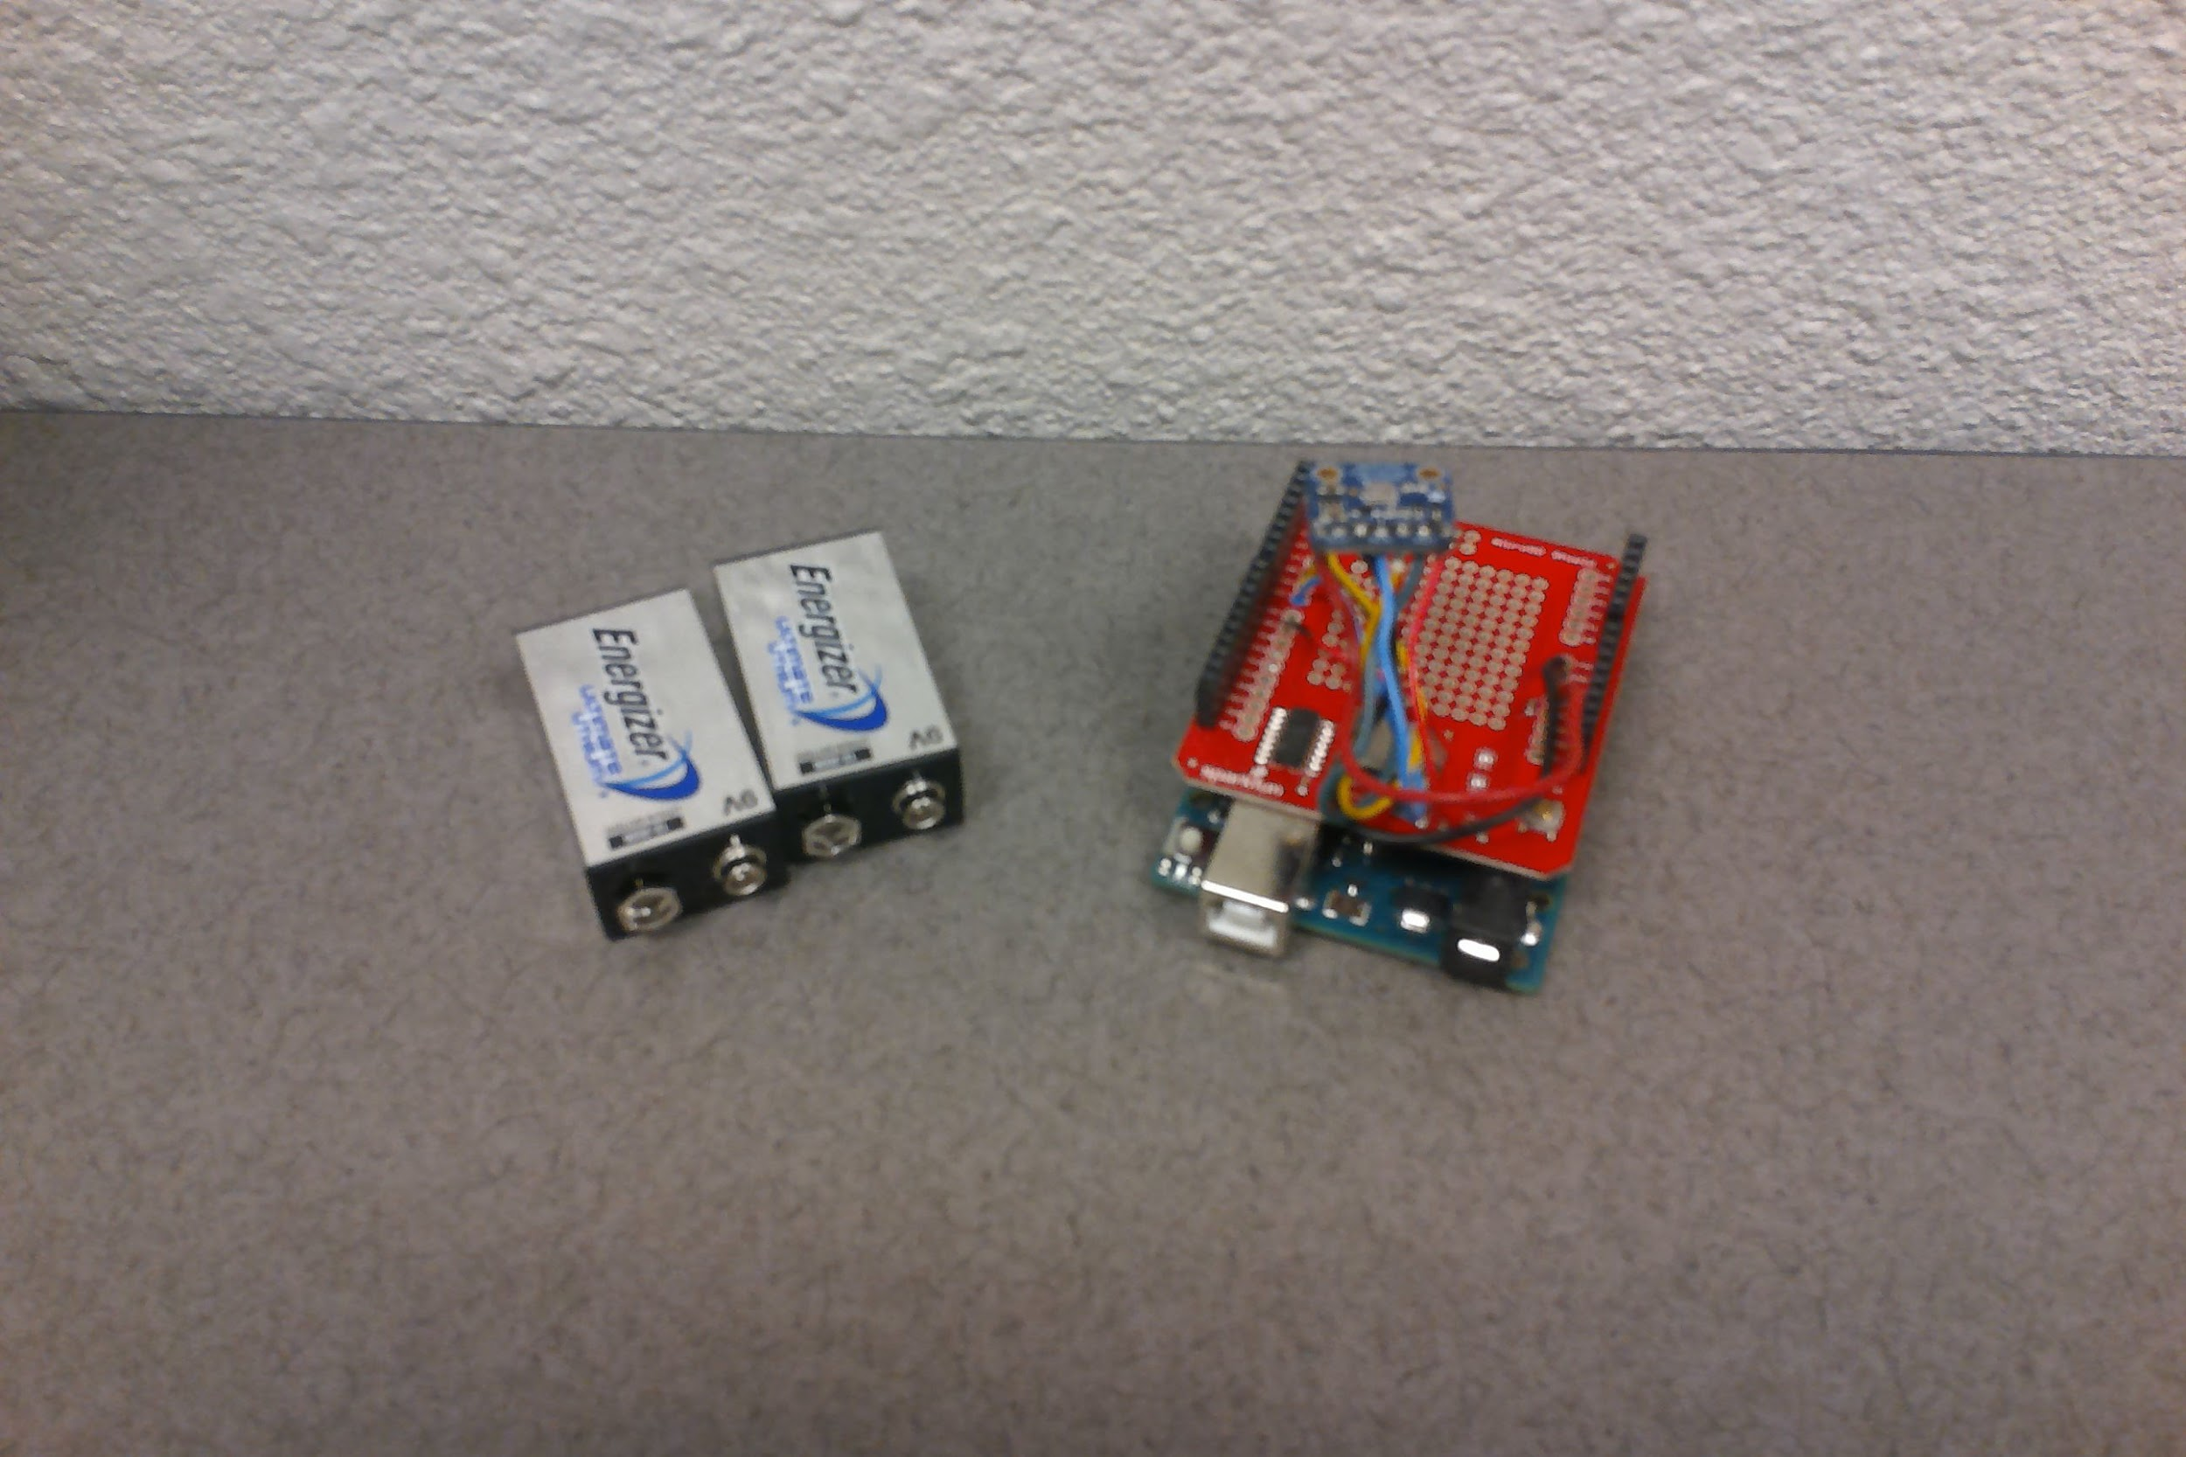
Hardware
Arduino Uno
Master/Control Unit
Sparkfun MicroSD Shield
Stores Data to 16GB MicroSD
Adafruit BMP183 Sensor
Barometer, Thermometer, and Altimeter
Serial Peripheral Interface (SPI)

Slide 4
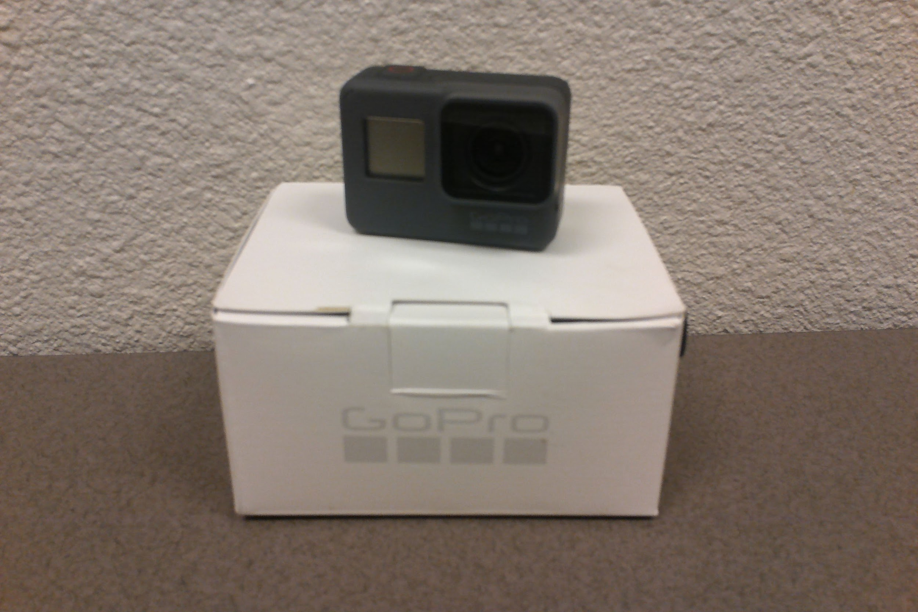
GoPro Hero 5 Black
Recording in 1080p / 30Fps
Optional features disabled to maximize recording time
Samsung 64GB MicroSD
“Quik” application allows the user to track camera location

Slide 5
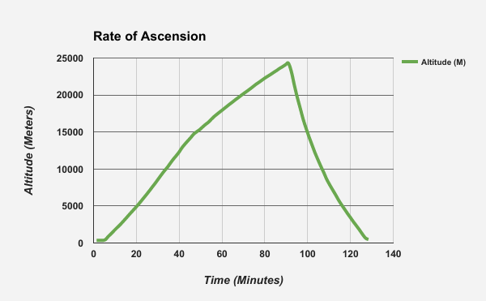
Altitude and Vertical Velocity
Launch Altitude: 350 meters
Max Altitude: 24,300 meters
Balloon Burst: 91 minutes
Balloon Fall Time: 37 minutes
Ascension Rates
V_{average} 4.38 meters per second
V_{max} 7.30 meters per second @ 12 km
Descension Rates
V_{average} 10.81 meters per second
V_{max} 22.15 meters per second @ 24.3 km

Slide 6
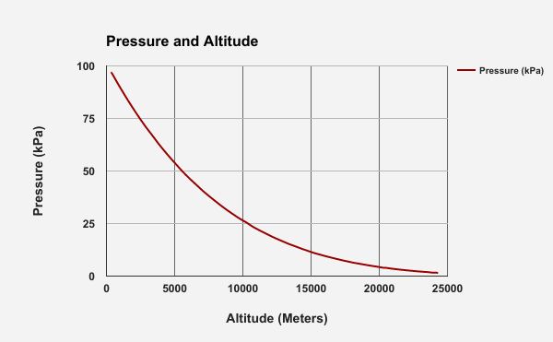
Near-Space Atmospheric Pressure
Pressure at Launch: 97 kPa @ 350 meters
Pressure at Burst: 1.55 kPa @ 24,300 meters
Atmospheric pressure approaches but does not reach zero.
lim = 0
x→ ∞

Slide 7
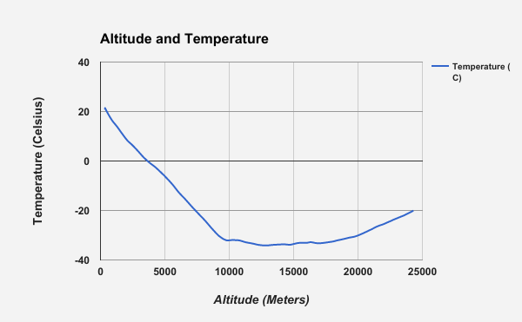
Near-Space Temperatures
Maximum Temperature: 21.4 C @ 0.3km
Minimum Temperature: -32.4 C @ 17km
Temperature decreases through the troposphere from until 10,000 meters.
Tropopause starts at 10,000 meters
Temperature increases through the stratosphere from 15,000-24,000

Slide 8
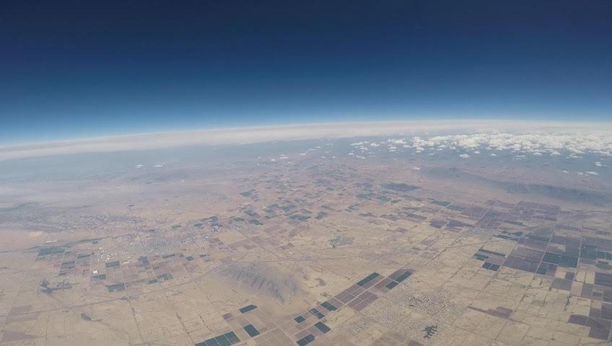
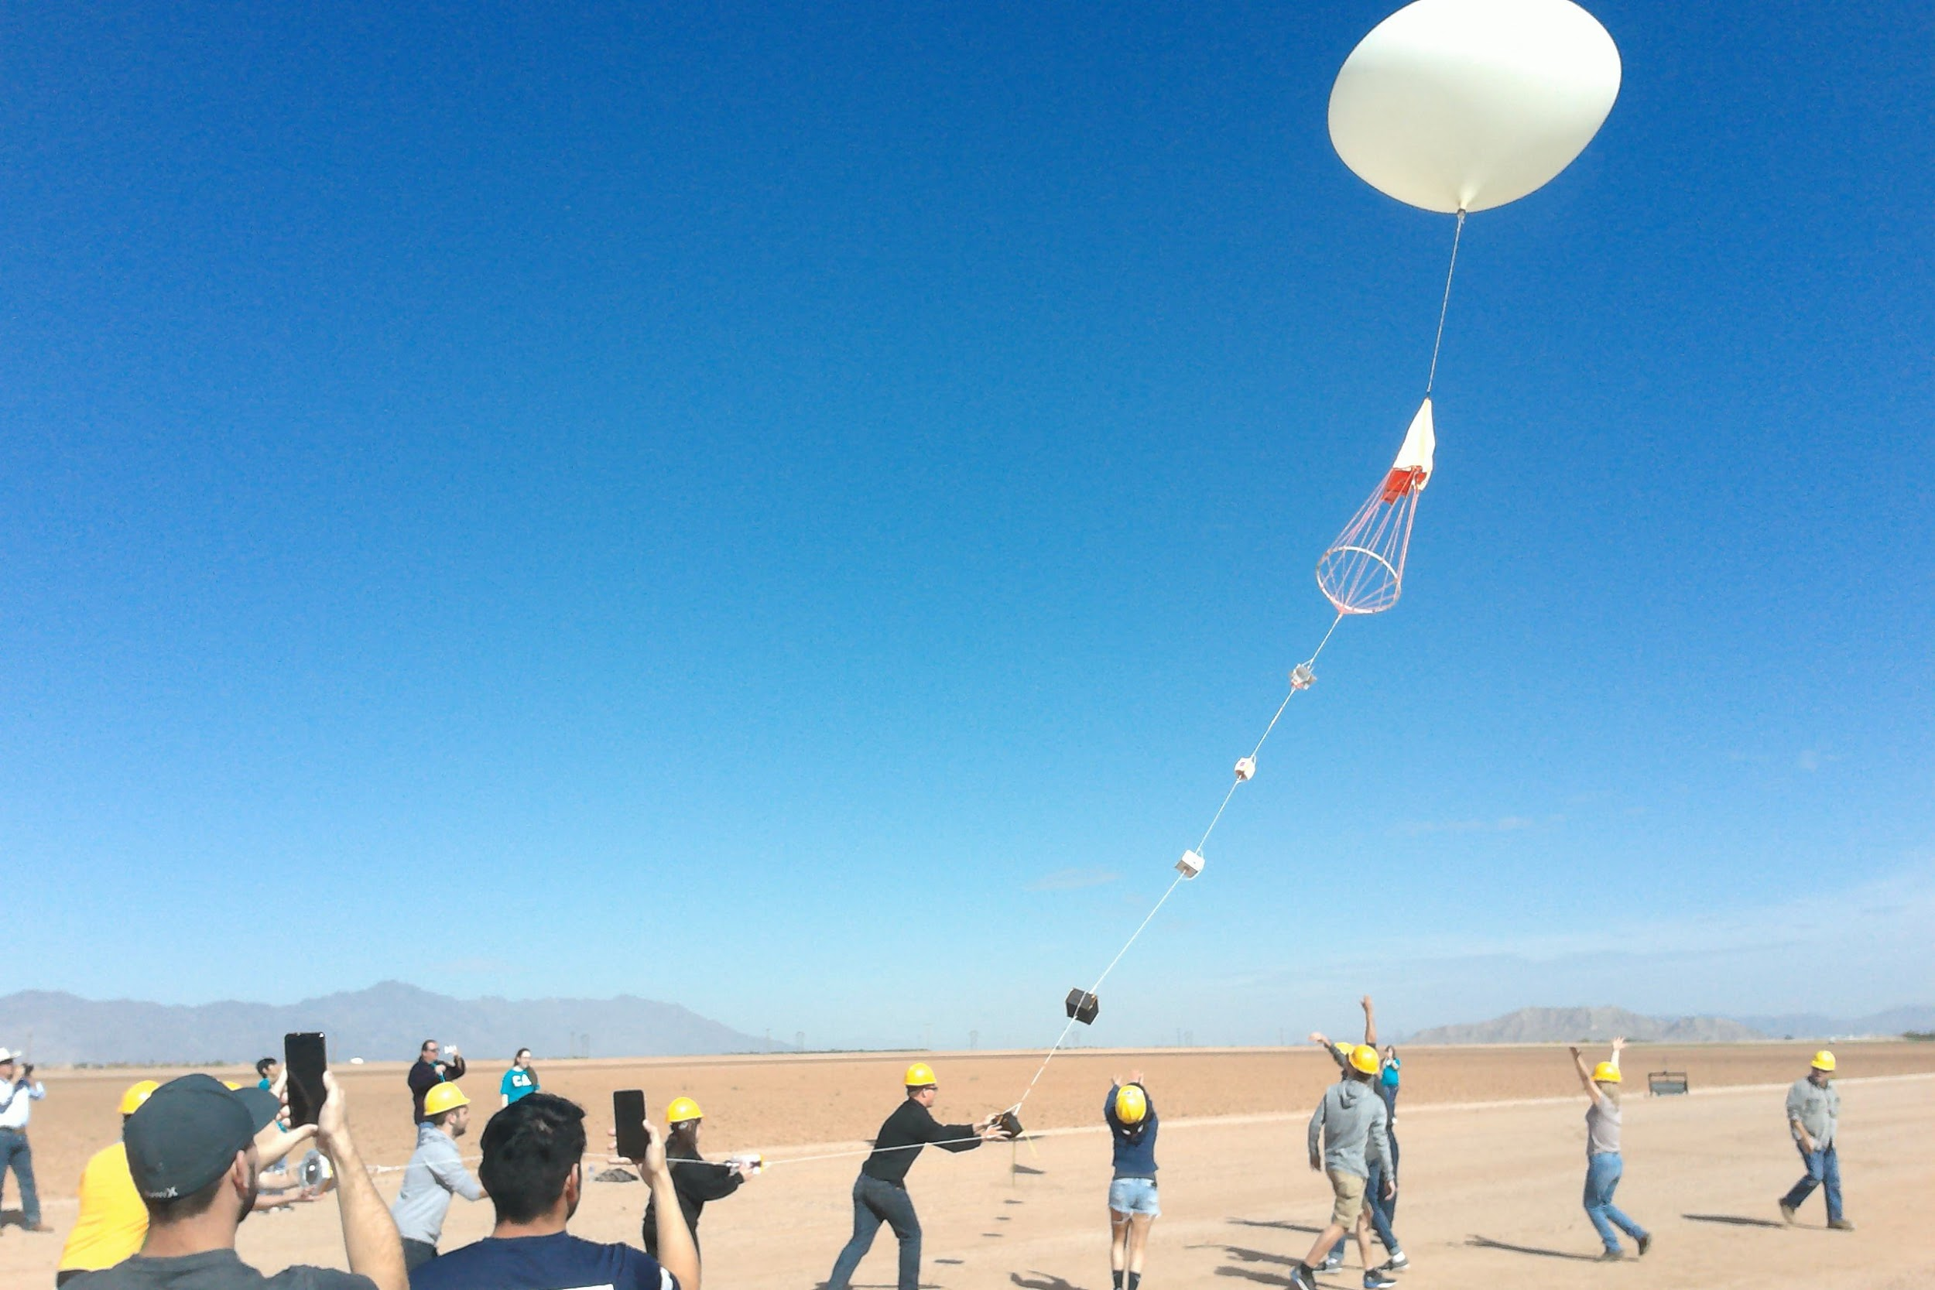
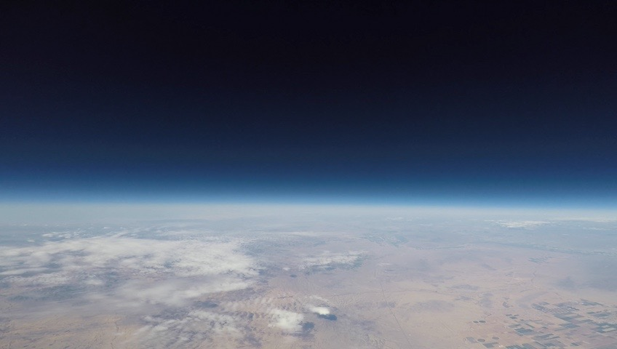
ANSR Flight #27
April 1, 2017

Slide 9
Special thanks to the following for offering this opportunity!:
Jack Crabtree and ANSR
Susan Brew and NASA Space Grant
Mike Sampogna
Pima Community College

